Slide 1
Simulation Results: Multitasking Sales Agents
Summer Research
Beomjoon Shim
October 2014

Slide 2


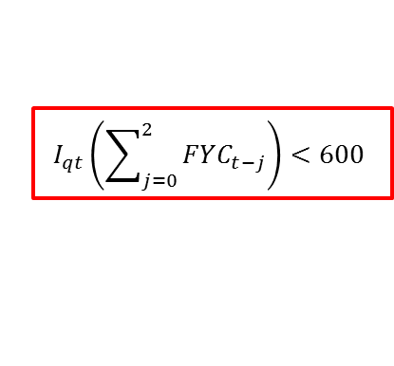
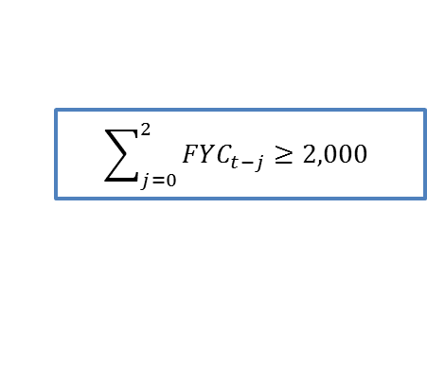
Introduction
In this simulation, I consider only salespeople at level 1 and level 2. (Level 2 is the maximum level of a salesperson.)
The simulation code can be extended to include the promotion and demotion of level 3 salesperson but the execution time will significantly increase.
$$P_{it}=2$$
Salesman
Demotion at quarter month
Promotion at any month
$$I_{qt}\left(\sum_{j=0}^{2}{FYC_{t−j}}\right)<600$$
$$\sum_{j=0}^{2}{FYC_{t−j}}≥2,000$$
$$P_{it}=1$$
Intern salesman

Slide 3
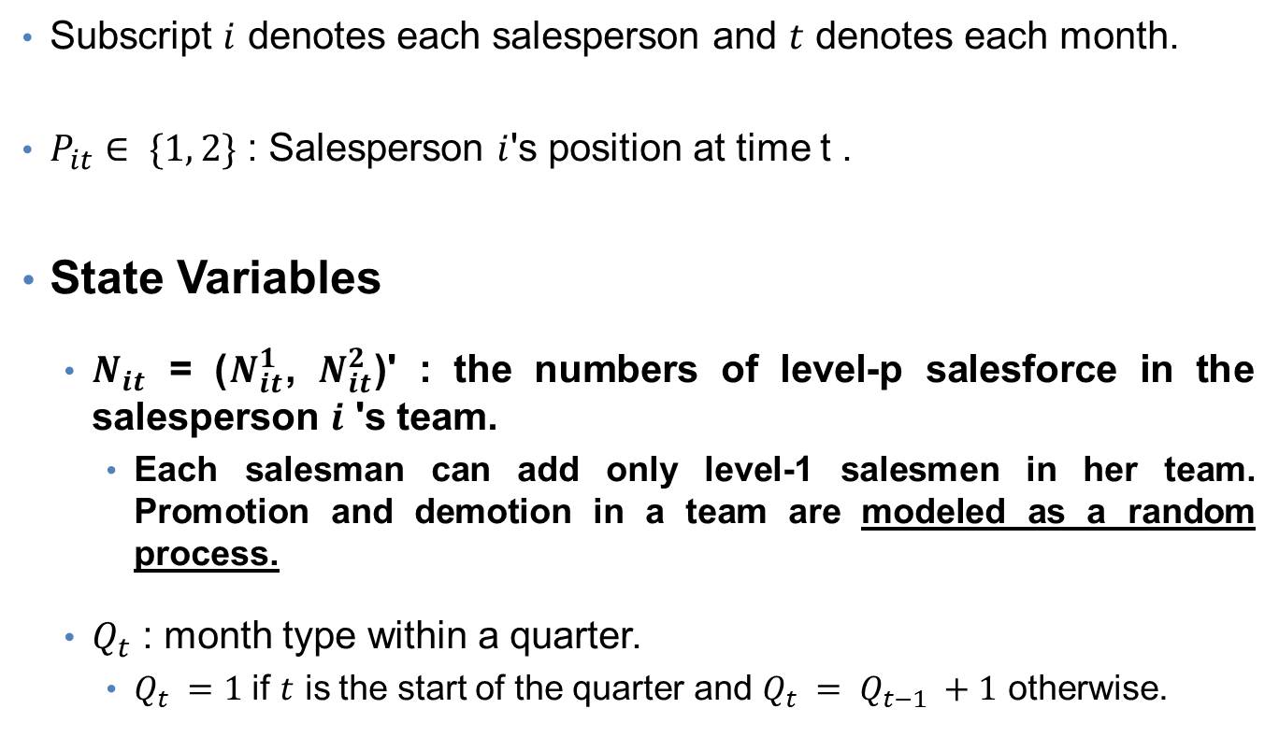
Models – Notation & State Variables
Subscript $i$ denotes each salesperson and $t$ denotes each month.
$P_{it}∈ \{1, 2\}$ : Salesperson $i$'s position at time t .
State Variables
$N_{it}$ = ($N_{it}^{1}$, $N_{it}^{2}$)' : the numbers of level-p salesforce in the salesperson $i$ 's team.
Each salesman can add only level-1 salesmen in her team. Promotion and demotion in a team are modeled as a random process.
$Q_{t}$ : month type within a quarter.
$Q_{t} =1$ if $t$ is the start of the quarter and $Q_{t} = Q_{t−1} +1$ otherwise.

Slide 4
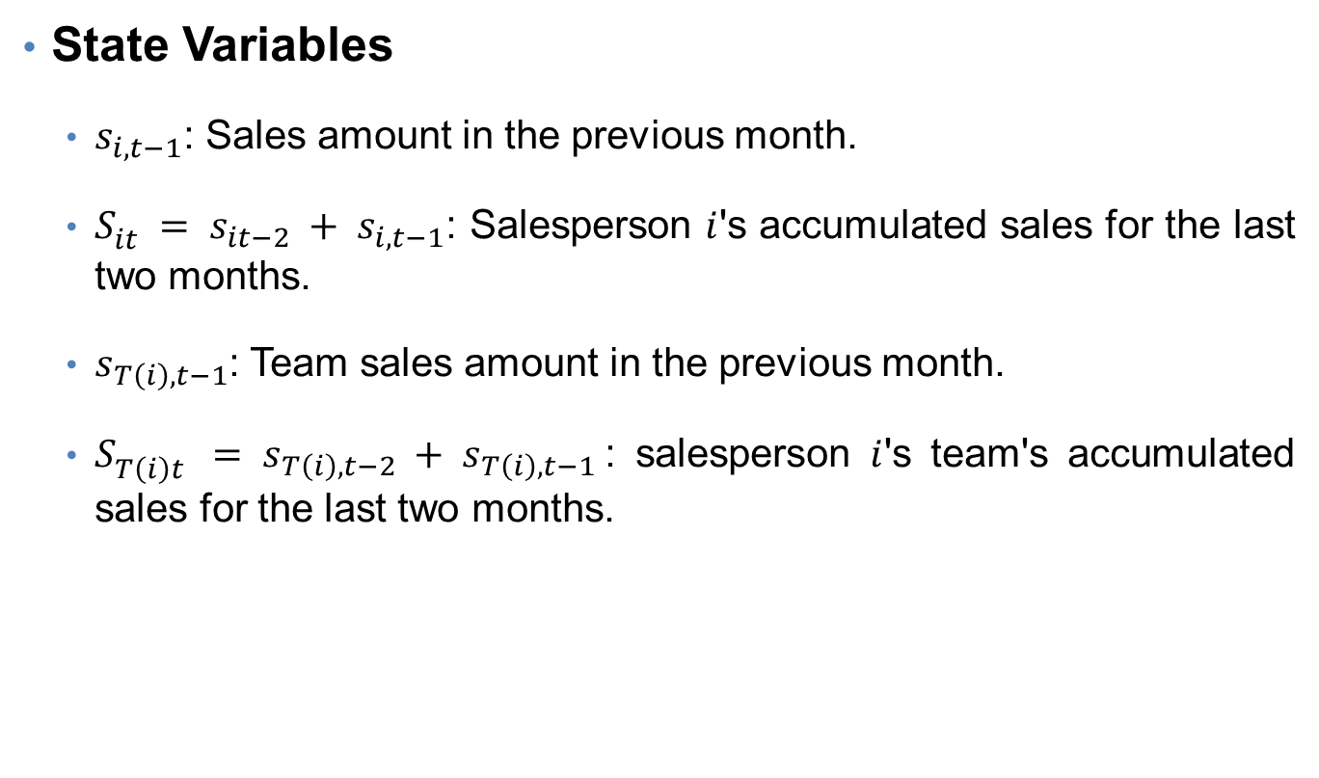
Models – State Variables
State Variables
$s_{i,t−1}$: Sales amount in the previous month.
$S_{it}^{} = s_{it−2} + s_{i,t−1}$: Salesperson $i$'s accumulated sales for the last two months.
$s_{T\left(i\right),t−1}$: Team sales amount in the previous month.
$S_{T\left(i\right)t }^{} = s_{T\left(i\right),t−2} + s_{T\left(i\right),t−1}$: salesperson $i$'s team's accumulated sales for the last two months.

Slide 5

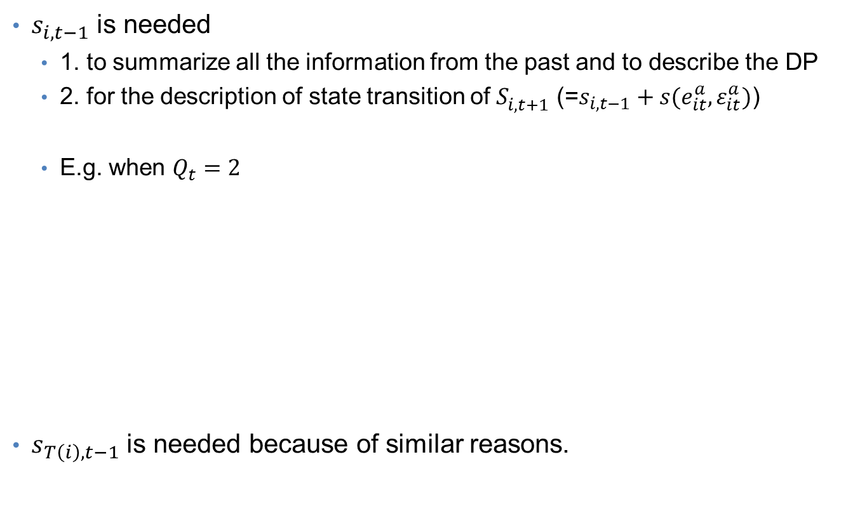



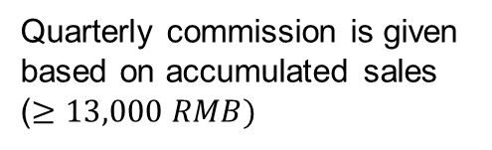
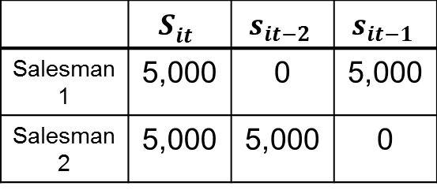
Why the state variables $s_{i,t−1}$ & $s_{T\left(i\right),t−1}$are needed?
$s_{i,t−1}$ is needed
1. to summarize all the information from the past and to describe the DP
2. for the description of state transition of $S_{i,t+1}^{}$ (=$s_{i,t−1}+s(e_{it}^{a},ε_{it}^{a})$)
E.g. when $Q_{t}=2$
$s_{T\left(i\right),t−1}$ is needed because of similar reasons.
$$Q_{t}=1$$
$$Q_{t}=2$$
$$Q_{t}=3$$
Quarterly commission is given based on accumulated sales ($≥13,000 RMB)$
 | $$S_{it}^{}$$ | $$s_{it−2}$$ | $$s_{it−1}$$
Salesman1 | 5,000 | 0 | 5,000
Salesman2 | 5,000 | 5,000 | 0

Slide 6
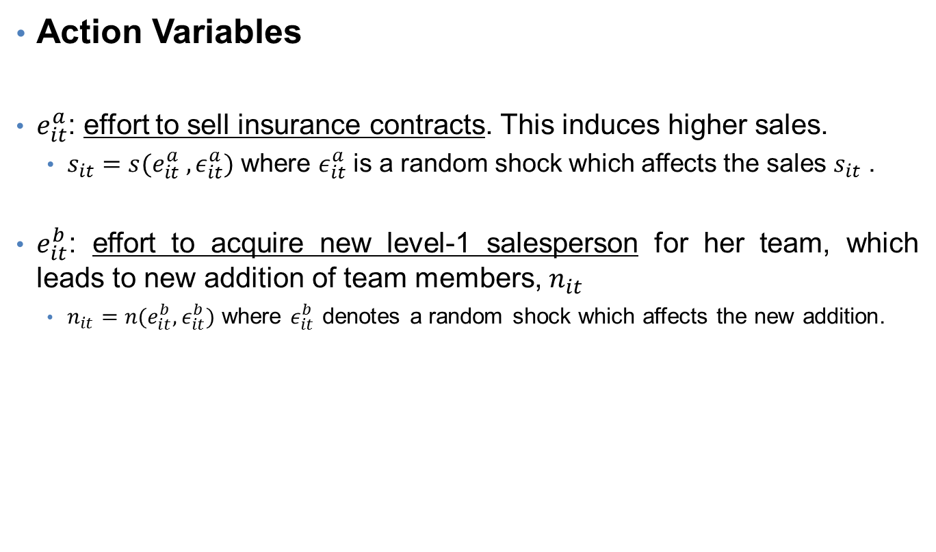
Models – Action Variables
Action Variables
$e_{it}^{a}$: effort to sell insurance contracts. This induces higher sales.
$s_{it}=s(e_{it}^{a} , ε_{it}^{a})$ where $ε_{it}^{a}$ is a random shock which affects the sales $s_{it}$ .
$e_{it}^{b}$: effort to acquire new level-1 salesperson for her team, which leads to new addition of team members, $n_{it}$
$n_{it}=n(e_{it}^{b}, ε_{it}^{b})$ where $ε_{it}^{b}$ denotes a random shock which affects the new addition.

Slide 7
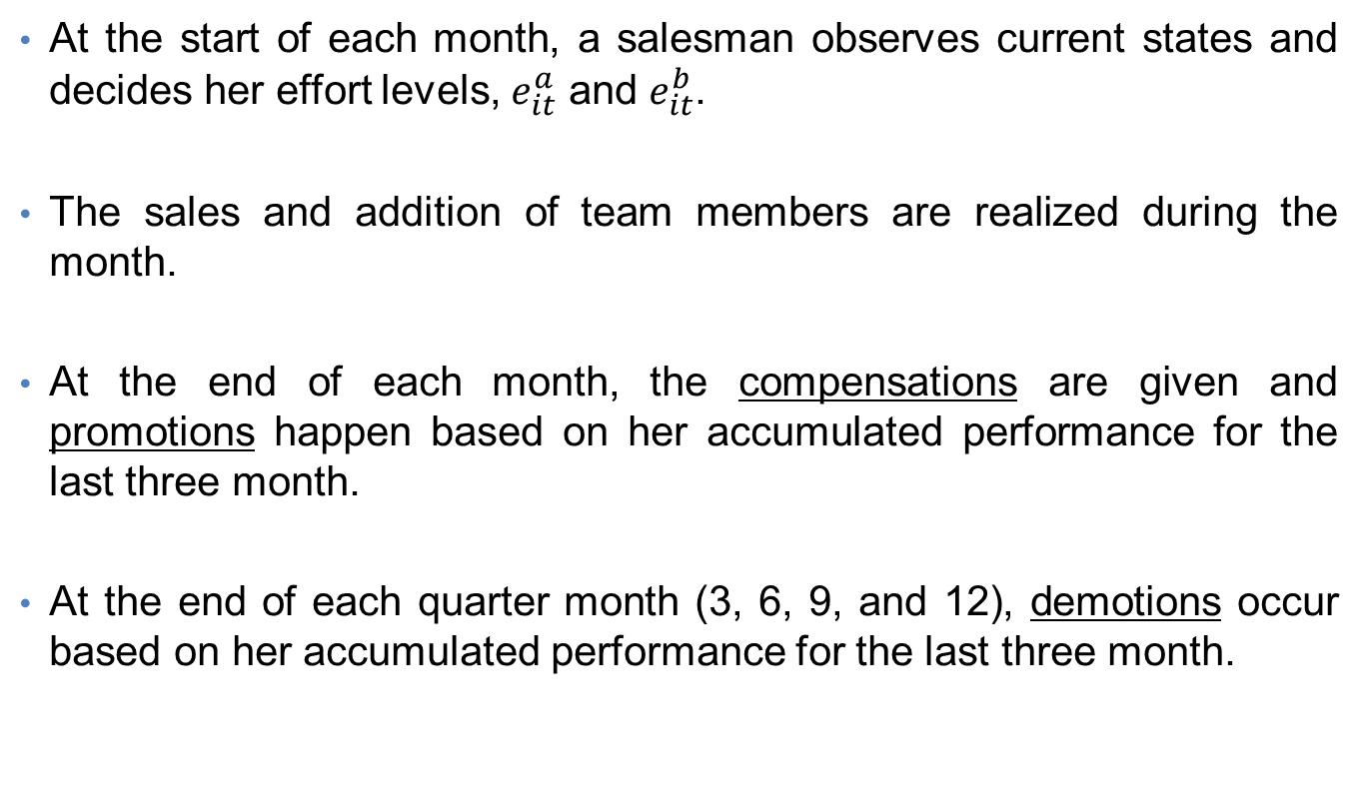
Timing of the Model
At the start of each month, a salesman observes current states and decides her effort levels, $e_{it}^{a}$ and $e_{it}^{b}$.
The sales and addition of team members are realized during the month.
At the end of each month, the compensations are given and promotions happen based on her accumulated performance for the last three month.
At the end of each quarter month (3, 6, 9, and 12), demotions occur based on her accumulated performance for the last three month.

Slide 8
Assumptions
(A1) I assume that a sales manager has no control over his whole team member's sales performance. This implies that once a salesperson is added to a team, his sales performance is stochastic.
(A2) I assume a monotonic relationship between effort and outcomes (i.e. sales and number of added salespeople).

Slide 9
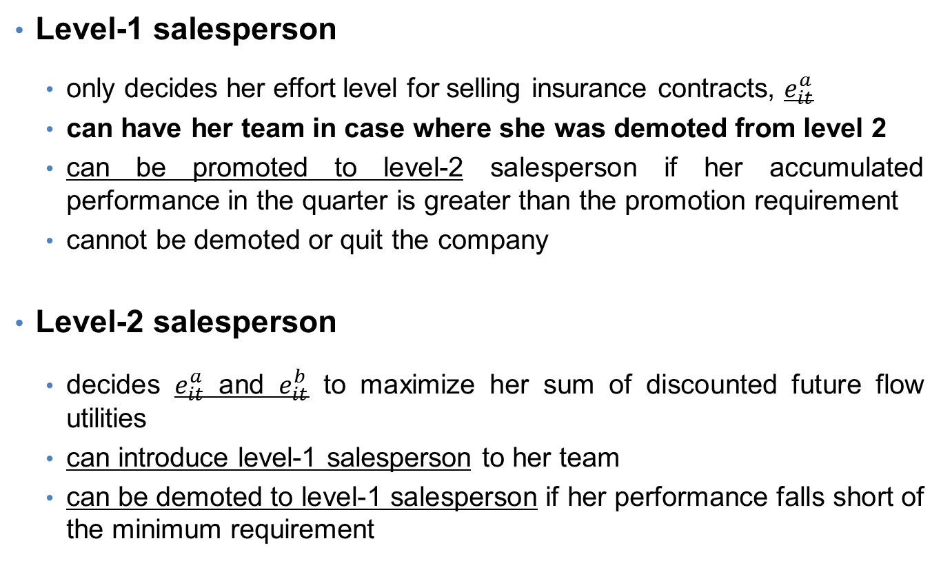
Preview of Model
Level-1 salesperson
only decides her effort level for selling insurance contracts, $e_{it}^{a}$
can have her team in case where she was demoted from level 2
can be promoted to level-2 salesperson if her accumulated performance in the quarter is greater than the promotion requirement
cannot be demoted or quit the company
Level-2 salesperson
decides $e_{it}^{a}$ and $e_{it}^{b}$ to maximize her sum of discounted future flow utilities
can introduce level-1 salesperson to her team
can be demoted to level-1 salesperson if her performance falls short of the minimum requirement

Slide 10

Models – Utility function
Flow utility of a salesperson of $i$ at $P_{it}=1 or 2$
$u\left(s_{it},n_{it}\right)$
$=0.3∗s_{it}+0.1∗0.3∗s_{T}\left(N_{it},ε_{it}^{T}\right)+I\left(Q_{t}=3\right)∗b_{q}$
$− ρ(e_{it}^{a},e_{it}^{b})$
Income from sales
Income from team-level sales
Quarterly commission
Cost of efforts

Slide 11





Models – Income from team-level sales
Level-1 salesperson can get income only from team members who are equal or below her level (i.e. only from level-1 team members).
As an illustration of the compensation rule, let’s consider the case below.
$$t=1$$
$$t=2$$
$$t=3$$
$$P_{it}=2$$
A
B
B
A
B
C
A
C
C
$$P_{it}=1$$
A adds B and C to her team. A gets paid for B’s and C’s sales.
A is demoted and B is promoted. A gets paid only for C’s sales
A is promoted. Now, A gets paid for both B’s and C’s sales

Slide 12
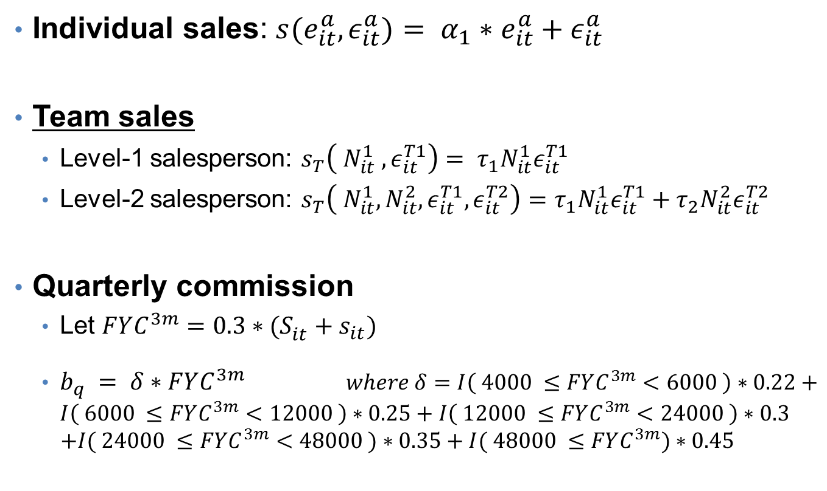
Models – Sales & Commission
Individual sales: $s(e_{it}^{a}, ε_{it}^{a})= α_{1}∗e_{it}^{a}+ε_{it}^{a}$
Team sales
Level-1 salesperson: $s_{T}\left( N_{it}^{1} ,ε_{it}^{T1}\right)= τ_{1}N_{it}^{1}ε_{it}^{T1}$
Level-2 salesperson: $s_{T}\left( N_{it}^{1},N_{it}^{2},ε_{it}^{T1},ε_{it}^{T2}\right)=τ_{1}N_{it}^{1}ε_{it}^{T1}+τ_{2}N_{it}^{2}ε_{it}^{T2}$
Quarterly commission
Let $FYC^{3m}=0.3∗{(S_{it}^{}+s}_{it})$
$b_{q} = δ∗FYC^{3m}$ $where δ=I\left( 4000 ≤FYC^{3m}<6000 \right)∗0.22+I\left( 6000 ≤FYC^{3m}<12000 \right)∗0.25+I\left( 12000 ≤FYC^{3m}<24000 \right)∗0.3$
$$+I( 24000 ≤FYC^{3m}<48000 )∗0.35+I( 48000 ≤FYC^{3m})∗0.45$$

Slide 13

Models – Cost & Adding Salespeople
Cost of efforts: $ρ\left(e_{it}^{a} , e_{it}^{b}\right)= θ_{1}{\left(e_{it}^{a}\right)}^{2}+θ_{2}{\left(e_{it}^{b}\right)}^{2}$
Adding new salespeople: $n_{it}^{∗} = βe_{it}^{b} + ε_{it}^{b}$
$n_{it}= 0 if n_{it}^{∗} ≤ 0,$
$1 if 0<n_{it}^{∗}≤ μ_{1} ,$
$2 if μ_{1} ≤n_{it}^{∗}$

Slide 14
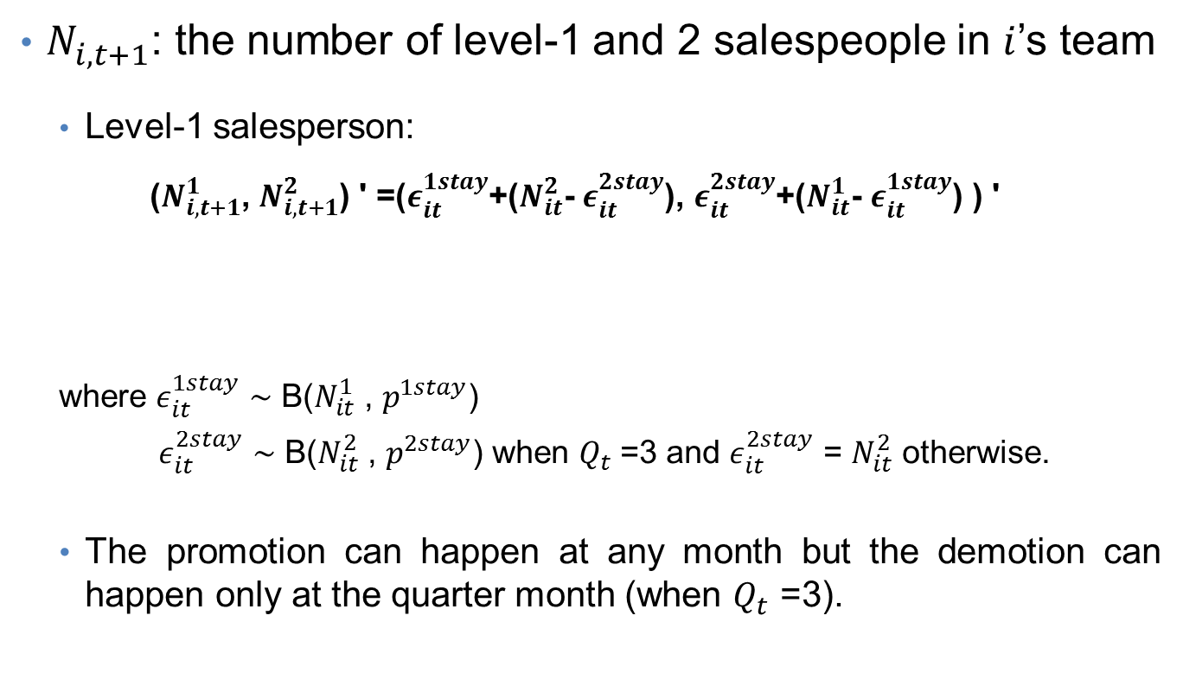
State Transitions
$N_{i,t+1}^{}$: the number of level-1 and 2 salespeople in $i$’s team
Level-1 salesperson:
($N_{i,t+1}^{1}$, $N_{i,t+1}^{2}$) ' =($ε_{it}^{1stay}$+($N_{it}^{2}$- $ε_{it}^{2stay}$), $ε_{it}^{2stay}$+($N_{it}^{1}$- $ε_{it}^{1stay}$) ) '
where $ε_{it}^{1stay}$ ∼ B($N_{it}^{1}$ , $p^{1stay}$)
$ε_{it}^{2stay}$ ∼ B($N_{it}^{2}$ , $p^{2stay}$) when $Q_{t}$ =3 and $ε_{it}^{2stay}$ = $N_{it}^{2}$ otherwise.
The promotion can happen at any month but the demotion can happen only at the quarter month (when $Q_{t}$ =3).
# of demoted salesperson from level 2
# of promoted salesperson from level 1

Slide 15
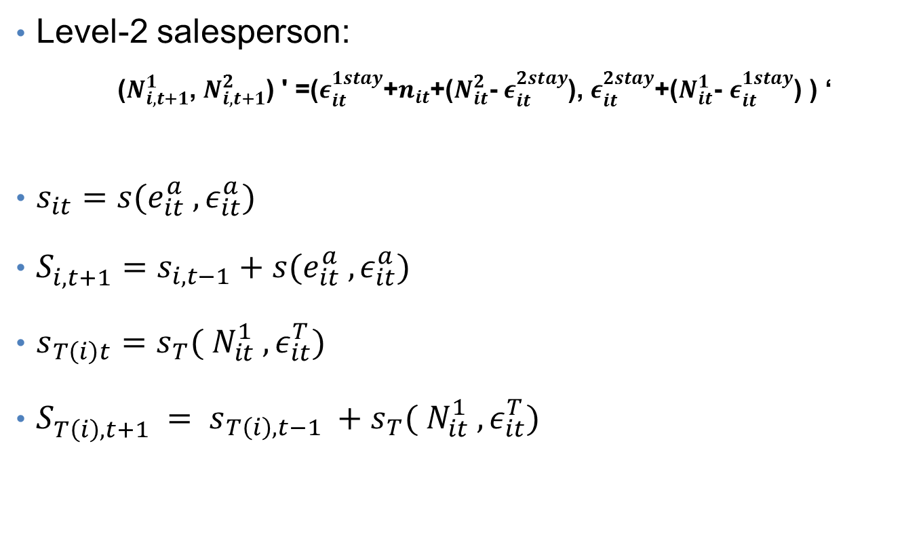
State Transitions
Level-2 salesperson:
($N_{i,t+1}^{1}$, $N_{i,t+1}^{2}$) ' =($ε_{it}^{1stay}$+$n_{it}$+($N_{it}^{2}$- $ε_{it}^{2stay}$), $ε_{it}^{2stay}$+($N_{it}^{1}$- $ε_{it}^{1stay}$) ) ‘
$s_{it}=s(e_{it}^{a} , ε_{it}^{a})$
$S_{i,t+1}^{}=s_{i,t−1}+s(e_{it}^{a} , ε_{it}^{a})$
$s_{T\left(i\right)t}=s_{T}( N_{it}^{1} ,ε_{it}^{T})$
$S_{T\left(i\right),t+1}^{} = s_{T\left(i\right),t−1} +s_{T}( N_{it}^{1} ,ε_{it}^{T})$
# of added team members

Slide 16
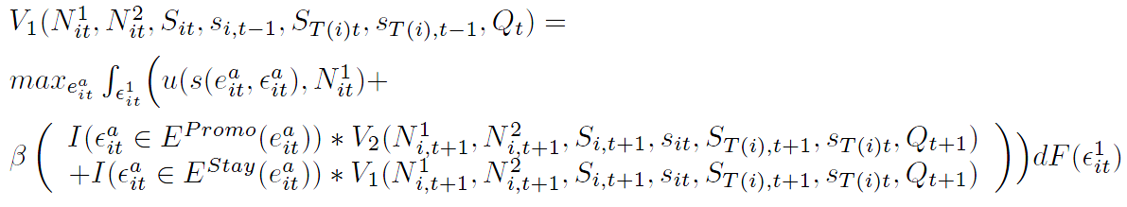

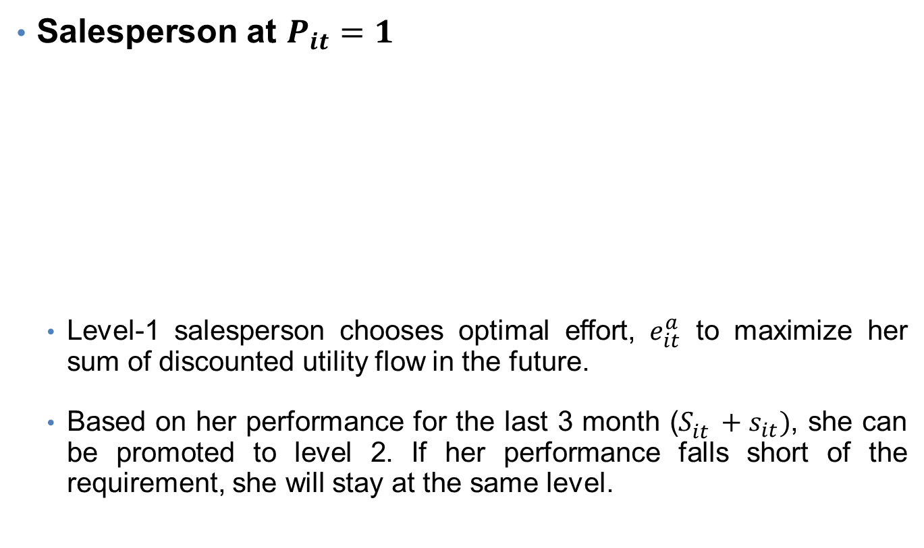
Salesperson’s Problem
Salesperson at $P_{it}=1$
Level-1 salesperson chooses optimal effort, $e_{it}^{a}$ to maximize her sum of discounted utility flow in the future.
Based on her performance for the last 3 month ($S_{it}^{}+s_{it})$, she can be promoted to level 2. If her performance falls short of the requirement, she will stay at the same level.

Slide 17
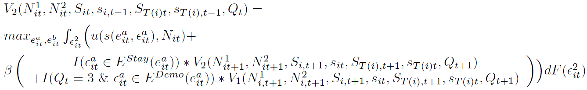

Salesperson’s Problem
Salesperson at $P_{it}=2$
Level-2 salesperson chooses her optimal effort for sales and for adding salespeople ($e_{it}^{a} \& e_{it}^{b}$).
If her performance for the last three months falls short of a requirement, she will be demoted to level 1.

Slide 18
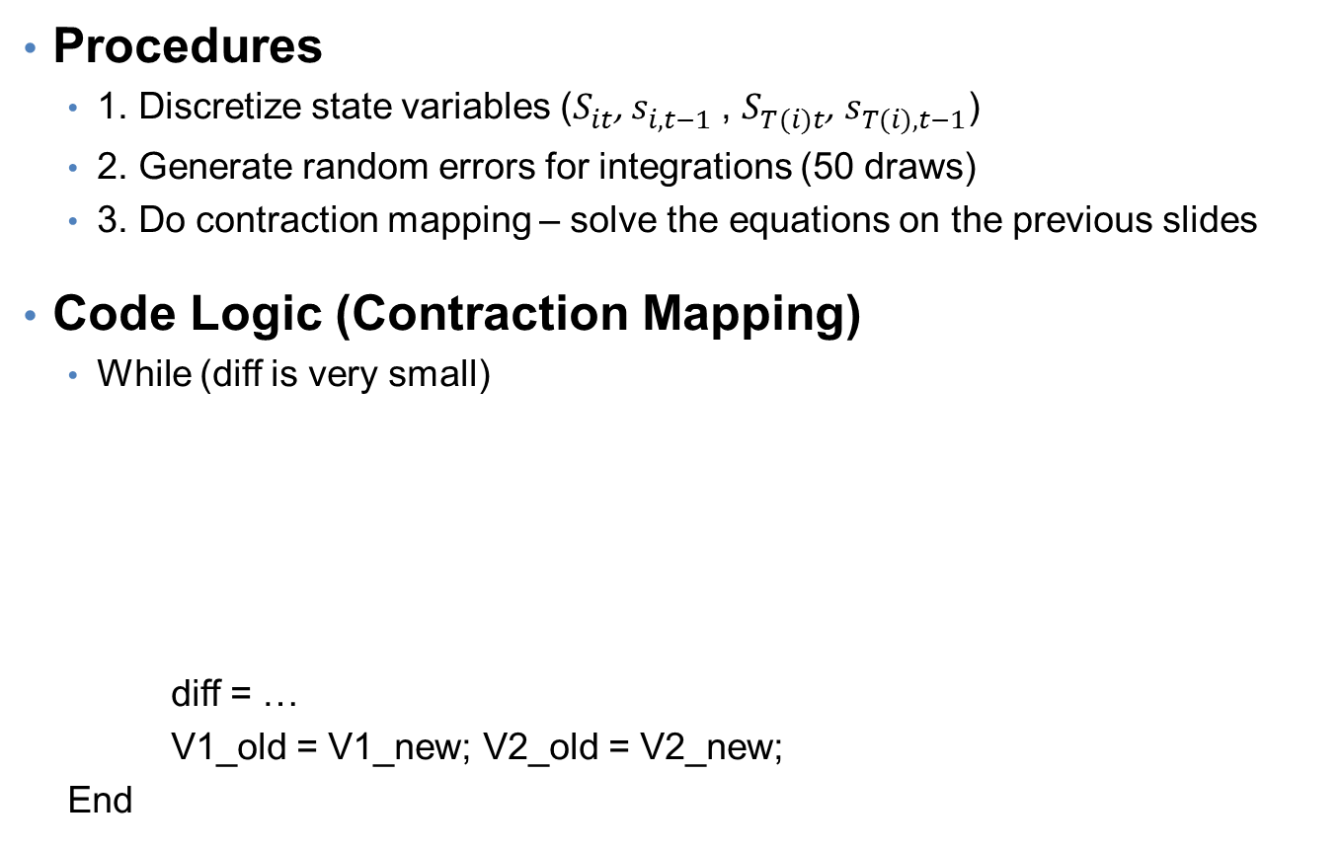
Implementation
Procedures
1. Discretize state variables ($S_{it}^{}$, $s_{i,t−1}^{}$, $S_{T(i)t}^{}$, $s_{T(i),t−1}^{}$)
2. Generate random errors for integrations (50 draws)
3. Do contraction mapping – solve the equations on the previous slides
Code Logic (Contraction Mapping)
While (diff is very small)
diff = …
V1_old = V1_new; V2_old = V2_new;
End
Lvl-1 salesperson’s problem
V1_new = f(V1_old,V2_old)
Lvl-2 salesperson’s problem
V2_new = f(V1_old,V2_old)

Slide 19
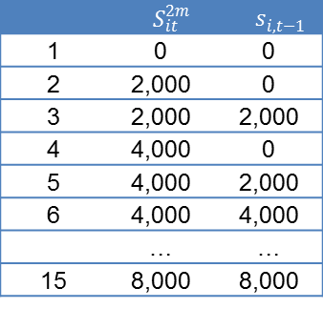

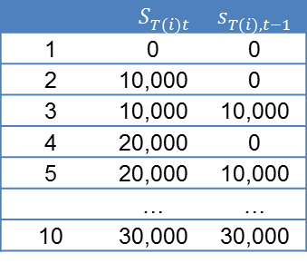
Simulation Settings – Discretize State Space
($S_{it}^{}$, $s_{i,t−1}^{}$) are considered as one state variable as below.
Similarly, ($S_{T(i)t}^{}$, $s_{T(i),t−1}^{}$) are considered as one state variable as above.
$N_{it}^{1}=[0 1 2 3]$ / $N_{it}^{2}=[0 1 2 3]$
$Q_{t}=[1 2 3]$
 | $S_{it}^{2m}$ | $s_{i,t−1}^{}$
1 | 0 | 0
2 | 2,000 | 0
3 | 2,000 | 2,000
4 | 4,000 | 0
5 | 4,000 | 2,000
6 | 4,000 | 4,000
 | … | …
15 | 8,000 | 8,000
 | $S_{T(i)t}^{}$ | $s_{T(i),t−1}^{}$
1 | 0 | 0
2 | 10,000 | 0
3 | 10,000 | 10,000
4 | 20,000 | 0
5 | 20,000 | 10,000
 | … | …
10 | 30,000 | 30,000

Slide 20

Simulation Settings - Generate random errors
$ε^{a}\sim N({0,200}^{2})$
$ε^{b}\sim N\left({0,30}^{2}\right)$
$ε^{T1}\sim U(0,1)$
$ε^{T2}\sim U(0,1.3)$
$ε^{Stay1}\sim B(N_{it}^{1},0.9)$
$ε^{Stay2}\sim B(N_{it}^{2},0.9$) when $Q_{t}=3$, $ε^{Stay2}$=$N_{it}^{2}$

Slide 21
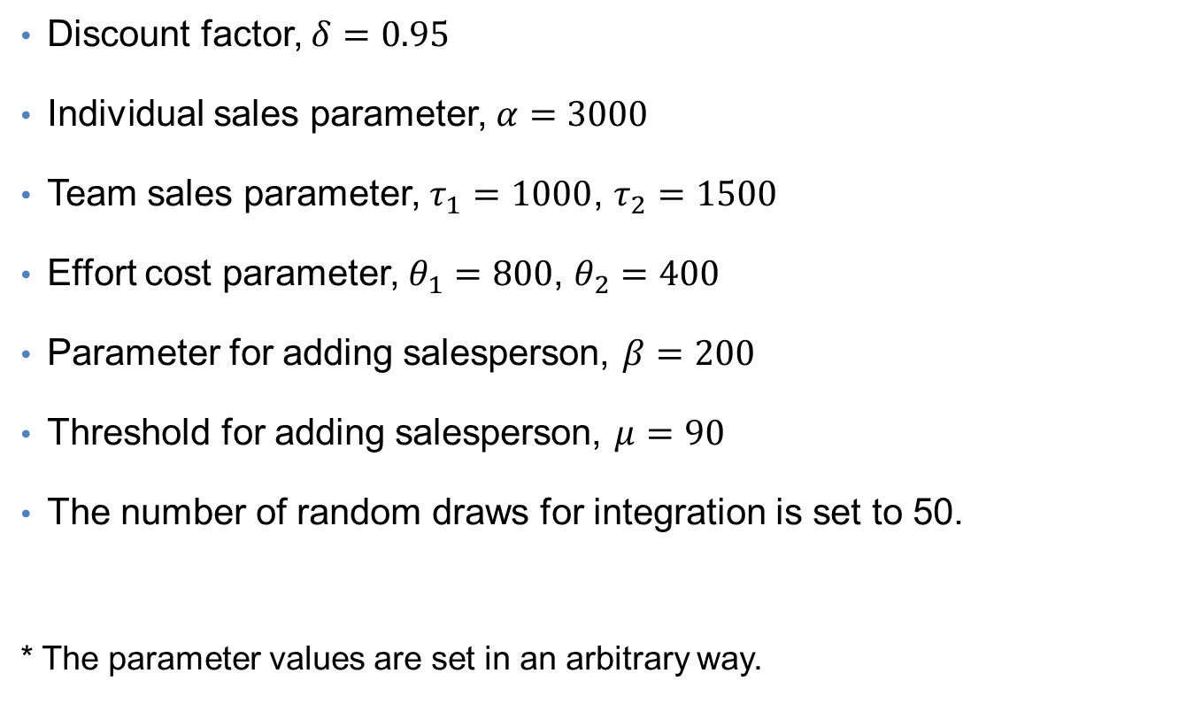
Simulation Settings – Parameters*
Discount factor, $δ=0.95$
Individual sales parameter, $α=3000$
Team sales parameter, $τ_{1}=1000$, $τ_{2}=1500$
Effort cost parameter, $θ_{1}=800$, $θ_{2}=400$
Parameter for adding salesperson, $β=200$
Threshold for adding salesperson, $μ=90$
The number of random draws for integration is set to 50.
* The parameter values are set in an arbitrary way.

Slide 22
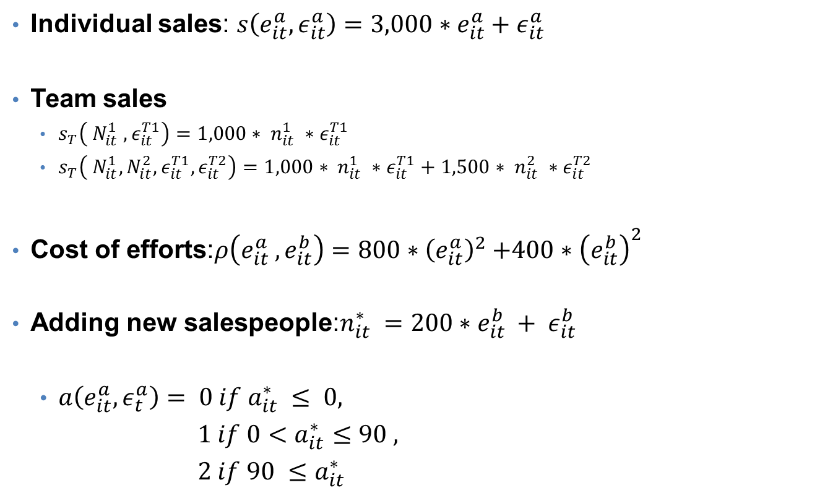
Simulation Settings – Parameters
Individual sales: $s\left(e_{it}^{a}, ε_{it}^{a}\right)=3,000∗e_{it}^{a}+ε_{it}^{a}$
Team sales
$s_{T}\left( N_{it}^{1} ,ε_{it}^{T1}\right)=1,000∗ n_{it}^{1} ∗ε_{it}^{T1}$
$s_{T}\left( N_{it}^{1},N_{it}^{2},ε_{it}^{T1},ε_{it}^{T2}\right)=1,000∗ n_{it}^{1} ∗ε_{it}^{T1}+1,500∗ n_{it}^{2} ∗ε_{it}^{T2}$
Cost of efforts:$ρ\left(e_{it}^{a} , e_{it}^{b}\right)=800{∗\left(e_{it}^{a}\right)}^{2}+400∗{\left(e_{it}^{b}\right)}^{2}$
Adding new salespeople:$n_{it}^{∗} =200∗e_{it}^{b} + ε_{it}^{b}$
$a\left(e_{it}^{a},ε_{t}^{a}\right)= 0 if a_{it}^{∗} ≤ 0,$
$1 if 0<a_{it}^{∗}≤90 ,$
$2 if 90 ≤a_{it}^{∗}$

Slide 23
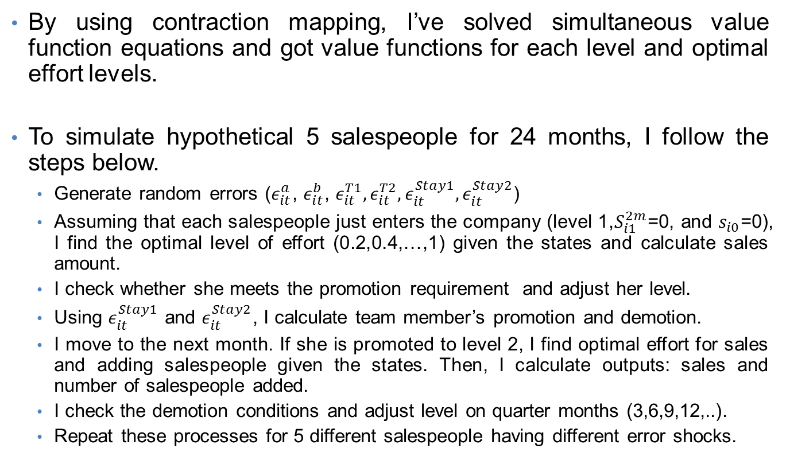
Implementation
By using contraction mapping, I’ve solved simultaneous value function equations and got value functions for each level and optimal effort levels.
To simulate hypothetical 5 salespeople for 24 months, I follow the steps below.
Generate random errors ($ε_{it}^{a}$, $ε_{it}^{b}$, $ε_{it}^{T1},ε_{it}^{T2},ε_{it}^{Stay1},ε_{it}^{Stay2}$)
Assuming that each salespeople just enters the company (level 1,$S_{i1}^{2m}$=0, and $s_{i0}$=0), I find the optimal level of effort (0.2,0.4,…,1) given the states and calculate sales amount.
I check whether she meets the promotion requirement and adjust her level.
Using $ε_{it}^{Stay1}$ and $ε_{it}^{Stay2}$, I calculate team member’s promotion and demotion.
I move to the next month. If she is promoted to level 2, I find optimal effort for sales and adding salespeople given the states. Then, I calculate outputs: sales and number of salespeople added.
I check the demotion conditions and adjust level on quarter months (3,6,9,12,..).
Repeat these processes for 5 different salespeople having different error shocks.

Slide 24
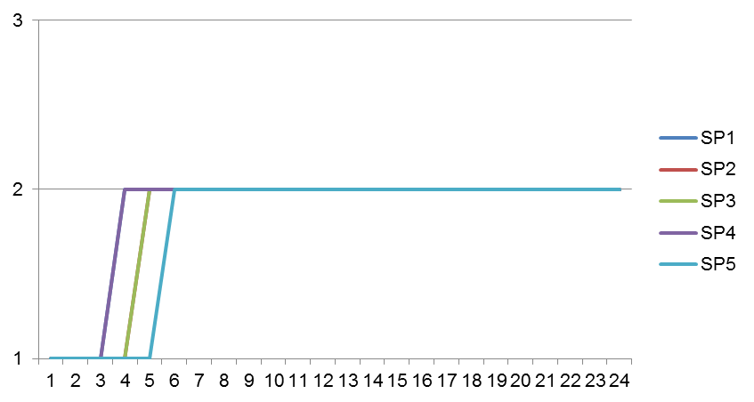
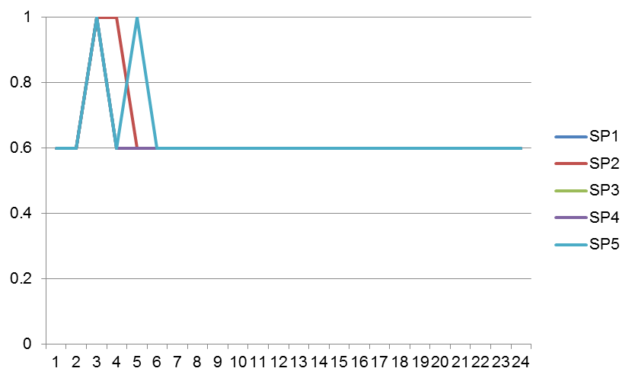
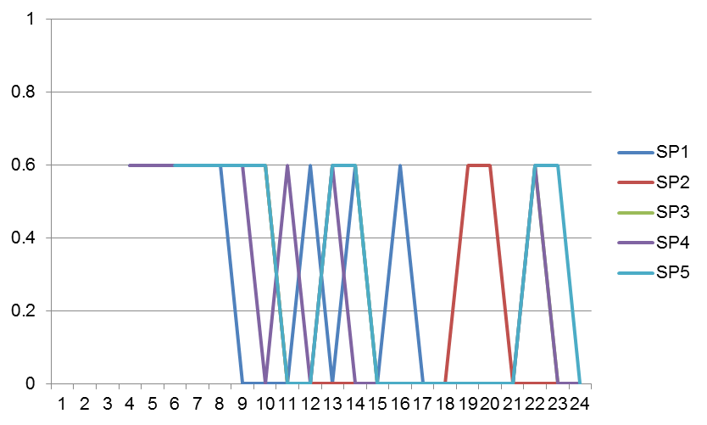

Simulation Results 1
Parameter values: $δ=0.95$, $α=3000$, $τ_{1}=1000$, $τ_{2}=1500$, $θ_{1}=800$, $θ_{2}=400$, $β=200$, $μ=90$ and $N_{it}^{1}=N_{it}^{2}=[0 1 2 3 4 5]$
Level change
Every salesperson is promoted within 5 month and starts to put efforts on adding salespeople in her team just after being promoted.
Since the team members are promoted and demoted, each salesperson continuously puts efforts
Effort for sales
Effort for adding salespeople

Slide 25
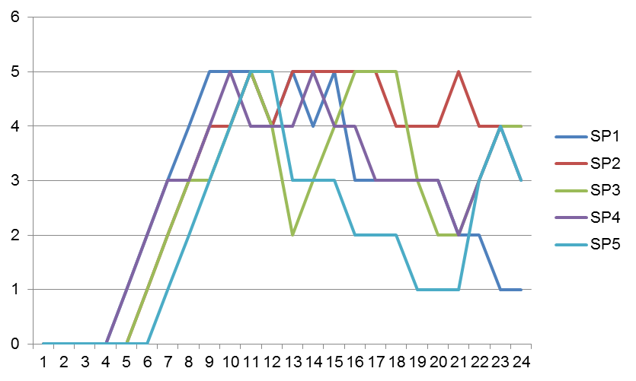
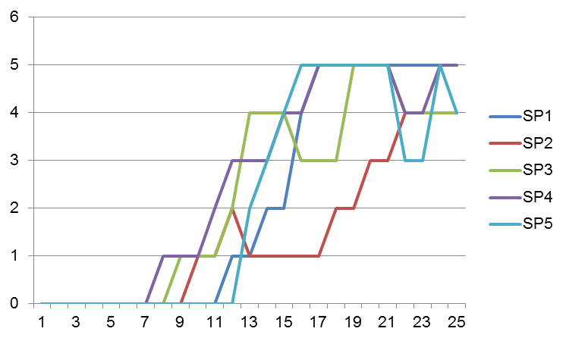

Simulation Results 1
Parameter values: $δ=0.95$, $α=3000$, $τ_{1}=1000$, $τ_{2}=1500$, $θ_{1}=800$, $θ_{2}=400$, $β=200$, and $μ=90$
After being promoted to level 2, each salesperson adds level 1 team members.
Since level 1 team members are randomly promoted to level 2, she adds more level 1 team members to her team.
# of level 1 team members
# of level 2 team members

Slide 26
Limitations and To Dos
Limitations
Even though the evolution of team members (i.e. random promotion and demotion) is included, the exit behavior of team members is not considered.
To Dos
Add level-3 salesperson in the model and simulation code.

